Slide 1
Dynamic Force Analysis of the Vehicles Motion on Rat Legs
Brandon Lim
Task: Dynamic Force Analysis of Rat Legs
Purpose of Task for the Feature: Ensure the safety of the A-Frame supports when dynamic forces of the vehicle are active on connecting track two.

Slide 2
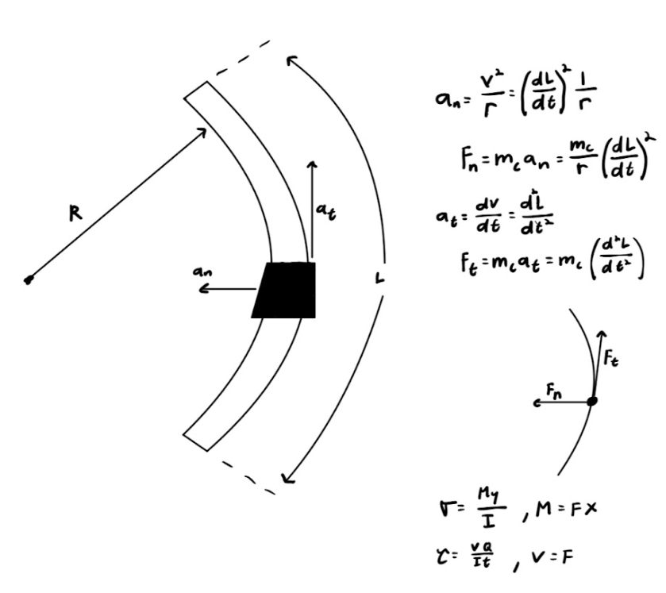
Dynamic Force Analysis

